Slide 1
^{Women’s}
^{Mental Health} ^{Training}
^{THINKING WELL,}
^{Living Well}
A Resource for Churches on Comprehensive Health Ministry

Slide 2
The Mind and Body Connection Part 1 - Connection and Community
Written by
Vicki Griffin

Slide 3
Strategies for Success
Stephen Covey in his book Seven Habits of Highly Effective People reminds us that there are three things to consider when developing habits. You need to know what to do, you need to know how to do it, and you need to be motivated to do it. And there is one more vital element: You need the power to do it.
Notes:
Strategies for Success
How do you change bad habits for good? Stephen Covey in his book Seven Habits of Highly Effective People reminds us that there are three things to consider when developing habits. You need to know what to do, you need to know how to do it, and you need to be motivated to do it. And there is one more vital element: You need the power to do it.
What’s the piece that’s missing for you? Do you know what you need to do to break free from your bad habit or addiction? Perhaps you know what you need to do but you don’t know how to do it. You try and try but nothing seems to be working. Or perhaps you know what to do and how to do it, but you just don’t have the passion or motivation to stick with it. You may have great intentions—”Monday I’ll quit; I’ll start over.” But the staying power seems to be lacking in your life.
As it has been explained, the brain is very responsive and changeable throughout life. You can change even when habits have been long entrenched in your lifestyle. Repetition is the creator of habits. The more times a thought or action is repeated, the more cemented it is in the brain.

Slide 4
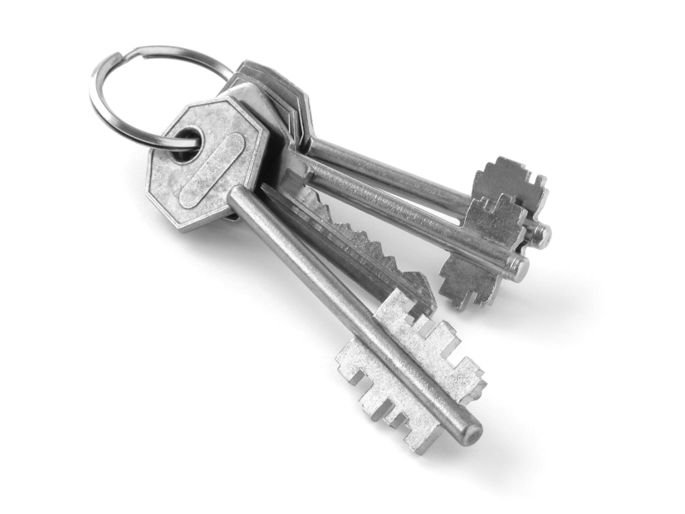
Three Keys
Create a Connection
Create a Community
Create a Positive LIfestyle
Notes:
In these two presentations, you will learn about three keys that will help you learn to be consistent in making positive choices. You will also discover the source for motivation and power that is essential for forming new habits.
Keys number one (Create a Connection)
and two (Create a Community) will be explained in Part 1 of these two seminars.
Key number 3 (Create a Positive Lifestyle) will be covered in Part 2.

Slide 5
Keys to Life
Not only are these keys powerful tools for overcoming bad habits and addictions, they are also the keys to successful and happy living. These keys will help you realize your full potential. Simple yet powerful!
Notes:
Keys to Life
Not only are these keys powerful tools for overcoming bad habits and addictions, they are also the keys to successful and happy living. These keys will help you realize your full potential. Simple yet powerful! Free and yet extremely valuable! They are for everyone—addicts and non-addicts alike.
Keys signify ownership, status, and worth. The keys to an abundant life are varied: Some are spiritual, some are emotional and social, and some are lifestyle. But they all unlock treasures that help develop their owner’s true status and worth, and that owner is you. A key is an especially valuable thing if it opens a treasure box. It is even more valuable if that treasure box is yours. But you must use the key to unlock each treasure for yourself. No one can do that for you. These units place the keys of life in your hands.
Each key is closely linked to other keys; none stands alone. For instance, when you strengthen one area of your life, such as having a positive mental attitude, it affects your physical health. When you live a healthful lifestyle and enjoy good physical health, it affects your mental health. When you have a strong spiritual life, your mental and physical health are enhanced. Working from all three angles will give you the tools for living free. You may start from any angle; each supports the other.

Slide 6
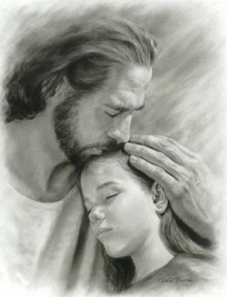
Key #1 Create a Connection
Embrace God
“Trust in the Lord with all your heart, and do not rely on your own insight. In all your ways acknowledge Him, and He will make straight your paths.”
Proverbs 3:5-6
Notes:
Key # 1: CREATE CONNECTION
Embrace God
One of the hardest struggles of the human heart is to realize the need of a power outside of oneself. It is natural to be independent; to try to solve all of life’s perplexities without help. But God, who created us, knows we need His help, power, and guidance in order to successfully manage ourselves and our life situation. We need to let God have control in our lives. Science is confirming that “spiritual well-being is at the center of a healthy lifestyle.” Individuals who personalize their religion, cultivate faith in God, and internalize spiritual values generally have better coping skills and less depression under stressful life events. The cultivation of a deeply personal religion is “strongly associated with life satisfaction.” One review stated it this way: “A large proportion of published empirical data suggests that religious commitment may play a beneficial role in preventing mental and physical illness, improving how people cope with mental and physical illness, and facilitating recovery from illness.”
Often the single biggest issue for someone struggling to break free from an addiction is trust. It is hard to relinquish the excessive need to control people or circumstances in an attempt to factor out potential pain. But if the need to control is not replaced with trust, a person will eventually replace one addiction with another.
The Bible teaches us that when we turn our lives over to God’s control, He will equip us to face life’s challenges, give us a new way of looking at life, give us reason to hope and trust, guide us in the right way, and at last grant us eternal life.
The counsel is inviting: “Trust in the Lord with all your heart, and do not rely on your own insight. In all your ways acknowledge Him, and He will make straight your paths.” Proverbs 3:5-6

Slide 7
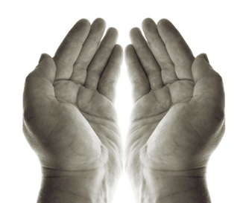
Key #1 Create a Connection
B. Connect with God through Prayer
“Prayer is the opening of the heart to God as to a friend. Not that it is necessary in order to make known to God what we are, but in order to enable us to receive Him. Prayer does not bring God down to us, but brings us up to Him.”
Ellen G. White, Happiness Digest, p. 44.
Notes:
B – Connect with God through Prayer
Prayer is a two-way conversation with God. There is no being in the universe more personally interested in you than God. Prayer opens your heart to hear His voice and receive His love, power, and guidance.
Modern science is beginning to recognize that “prayer is an integral component of the spiritual life of mankind. Clients in crisis may need prayer for encouragement, comfort, and support.” In addition, “prayer allows people to express themselves during crisis and emotional turmoil. It can serve as an important source of personal strength and as a foundation for self-resilience during times of adversity.” A study involving nearly 3,000 adults ages 19 to 97, found that recent alcohol disorders were less common among those who frequently read the Bible or prayed privately.
Another study showed that persons who considered themselves to have a personal connection with God or a higher power were much more likely to experience better health. Among teenagers, “personal religiosity is positively correlated with rejection of substance abuse, even after controlling for individual differences in personality.”
But in reality, prayer is a phenomenon whose results defy statistics, scientific measurement, and even our limited human reasoning. Prayer is the key to a limitless treasure, because when we pray we are connecting with the Infinite God and our Creator, who asks us to come to Him with our needs. “Trust in Him at all times; O people, pour out your heart before Him: God is a refuge for us.” (Psalm 62:8) God stands behind His promises.
Ellen G. White wrote in Happiness Digest “Prayer is the opening of the heart to God as to a friend. Not that it is necessary in order to make known to God what we are, but in order to enable us to receive Him. Prayer does not bring God down to us, but brings us up to Him.” (p. 44)

Slide 8
Key #1 Create a Connection
Through prayer God can cleanse us from destructive habits. “And I will make you free from all your unclean ways.”
Ezekiel 36:29
Notes:
Through prayer God can cleanse us from destructive habits. “And I will make you free from all your unclean ways.” (Ezekiel 36:29) He also promises us the power to stop doing the things we know are destroying us: “And I will put my spirit in you, causing you to be guided by my rules, and you will keep my orders and do them.” (Ezekiel 36:27) “Likewise the Spirit helps us in our weakness; for we do not know how to pray as we ought, but the Spirit himself intercedes for us with sighs too deep for words.” (Romans 8:26)
As God changes our attitude about our destructive habits, He promises to fill us with peace as He helps us negotiate life’s challenges and trials: “Have no anxiety about anything, but in everything by prayer and supplication with thanksgiving let your requests be made known to God. And the peace of God, which passes all understanding, shall keep your hearts and minds through Christ Jesus.” (Philippians 4:6-7) Prayer is the key in the hand of faith that unlocks heaven’s treasure-house of power.
It starts with a simple prayer: “God, teach me how to pray. Show me your way. Help me to love what you love and despise what you despise.”

Slide 9
Key #1 Create a Connection
C. Connect with God through Study
God’s Word, the Bible, provides instruction for living. It gives insight and understanding for the big picture in life as well as the details. “The entrance of Your words gives light; It gives understanding to the simple.”
Psalm 119:130
Notes:
C. Connect with God through Study
Have you ever been hopelessly lost on a trip, with no map and no one around who seemed to know your destination? You drive around and around and get nothing but frustration and an empty gas tank. In a similar way, people try to fix their problems, find happiness, and forge a future without seeking God or reading His Word. It doesn’t take long to wind up empty and frustrated.
God’s Word, the Bible, provides instruction for living. It gives insight and understanding for the big picture in life as well as the details. “The entrance of Your words gives light; It gives understanding to the simple.” (Psalm 119:130) The Bible inspires hope, faith, and courage in the heart of the reader. It revives the sorrowful and depressed. “Your word [is] to me the joy and rejoicing of my heart, for I am called by Your name, O LORD God of hosts.” (Jeremiah 15:16) It also brings conviction of sin in our life, and offers forgiveness and cleansing through the Savior, Jesus Christ. “If we confess our sins, He is faithful and just to forgive us our sins and to cleanse us from all unrighteousness.” (1 John 1:9)
In the same way that we can’t survive physically by having an occasional meal, we can’t survive spiritually by listening to an occasional sermon or having an occasional Bible study. Transformation, growth, and maturity in our thinking and lifestyle involve a process, not an event. When you have surrendered your life to God, don’t expect to wake up one morning and have everything figured out and be able to perform perfectly in every area of your life. You need daily time in God’s Word. And daily, little by little, it will transform your life and character.

Slide 10
Key #1 Create a Connection
God’s grace will cover your mistakes and give you the perseverance you need to continue your journey.
“Therefore, if anyone is in Christ, he is a new creation; old things have passed away; behold, all things have become new.”
2 Corinthians 5:17.
Notes:
God’s grace will cover your mistakes and give you the perseverance you need to continue your journey. Your thinking, attitude, and lifestyle will daily come more into harmony with His will. Over time, positive choices that were once difficult and took a great deal of prayer and struggle will become a part of the new character God is creating in you. “Therefore, if anyone is in Christ, he is a new creation; old things have passed away; behold, all things have become new.” (2 Corinthians 5:17)
God will speak to you personally in His Word. He is there for you.

Slide 11
Key # 2 Create a Community
God created us with a need for one another. . It is important, so far as possible, to create a community of support. Surround yourself with people who will encourage and support you in your positive choices.
Notes:
Key #2: CREATE COMMUNITY
God created us with a need for one another. It is important, so far as possible, to create a community of support. Surround yourself with people who will encourage and support you in your positive choices. Sever the relationships that you know are pulling you in the wrong direction.
Any building that stands the test of time and weather must not only have a good foundation; it also must have a solid support system built into that structure. Having an internal foundation of trust in God, hope, and prayer is vital. But social support is like the walls of that structure. It is important for developing the ability to cope with life’s challenges, and developing social skills, empathy, sound judgment, and wisdom. It is not uncommon for people to retreat into a world of isolation and addiction because they lack these basic functional tools necessary for emotional and social survival.
However, support does not mean relying wholly on others or circumstances for self-esteem, security, and self-definition. People and circumstances change; but God’s estimation of your value does not change. He declares that you are His treasure, and that you are greatly loved. Having a good support system is healthy and beneficial, but frail human beings are subject to err, and our basic sense of worth cannot be based on the opinions of others. Even best friends can disappoint us at times.
The only One who loves us perfectly is God, because He is love. He loved us before we loved Him, and He loves us even though we are flawed. When we accept His perfect love and His estimation of our value, then we are free to love others in spite of their flaws. Others cannot pay back years of emotional debt that is owed. Our need for support and love from others must be balanced by an understanding of our basic worth; in this way our expectations of others will not be unreasonable and exaggerated. We will also experience less pain when people disappoint us.

Slide 12
Key # 2 Create a Community
When we associate ourselves with people who have positive attitudes, good problem-solving abilities, and healthy relationships, we can learn from their example.
Healthy social ties are worth developing.
Find ways to connect with people who provide a positive influence on your life.
Notes:
Building a network of social support to aid recovery from addiction often requires severing unhealthy relationships that are destructive and feed on failure. Jane struggled with cocaine and alcohol for years, and found herself back in jail after she rationalized that she could help fellow addicts who were still using drugs. The desire for maintaining old ties was stronger than the conviction that she must change her associations. The internal strength and personality tools for helping her friends were not developed.
Predictably, she soon joined them in their destructive activities. She spent four months in jail for that decision. Now she is out of jail and, realizing her mistake, has surrounded herself with positive people who do not use drugs or alcohol. Jane attends a support group, and has established church ties and social relationships at work with people who do not live in the world of drugs and alcohol. She has completed high school, and has set her sights on college.
Someone once said: “Always be reading a book that is a little too hard for you, and surround yourself with people who are a little wiser than you.” When we associate ourselves with people who have positive attitudes, good problem-solving abilities, and healthy relationships, we can learn from their example.
Healthy social ties are worth developing. Numerous studies have linked a positive social life with improved mental health, less sickness and depression, higher levels of optimism, and longer life. Find ways to connect with people who provide a positive influence on your life. People join church groups, bicycle clubs, cooking classes, exercise classes, hobby groups, community projects, and volunteer associations. These are all great ways to connect with positive people and have fun at the same time.
It takes time to develop strong bonds of friendship and community with others. Take time to strengthen your friendships. Get closer to supportive family members. Be actively involved in your church family and community organizations. Time invested in cultivating positive friendships and activities is time well spent, and will expand, enrich, and energize your world.

Slide 13
Experience Forgiveness
Is there someone whom you need to forgive? There is an old saying that “when you forgive, you set a prisoner free—and that prisoner is you.”
FORGIVE.
Notes:
Experience Forgiveness
Sometimes the greatest hindrance to forming lasting relationships is unrealistic expectations of others, and holding on to hard feelings when others make mistakes. Holding on to past hurts can hinder present relationships because of unresolved bitterness, anger, and lack of forgiveness. Angry, bitter people have a hard time making or keeping relationships for this reason. It is often difficult for them to keep problems in their proper perspective. They will catastrophize and picture the worst scenario in every situation, which usually does make it worse—this is not a formula for building lasting friendships.
Is there someone whom you need to forgive? There is an old saying that “when you forgive, you set a prisoner free—and that prisoner is you.” The dictionary defines forgiveness as “giving up resentment, granting relief from payment, or ceasing to feel resentment against an offender.” Forgiving an injury is an active virtue that requires a conscious decision to part with angry, hostile, bitter feelings associated with the wrongs committed against you. It is a process of emotional release that can be difficult but is nonetheless essential to spiritual, mental, and physical well-being. “Forgiveness is not a quick fix,” cautions Robert D. Enright, Ph.D. It is a “matter of willed change of heart, the successful result of an active endeavor.”
Anger, hostility, resentment, and bitterness are associated with numerous physical and psychological ailments, and even a shortened lifespan. Often unforgiving people hurt not only themselves but others, either psychologically or physically. Hurting people hurt other people. Unforgiving people often have a hard time forgiving themselves for the wrongs they have committed; they are eaten up with denial, guilt, and shame.
Motivational speaker Zig Zigler has said that it is a dangerous thing to drive a car by looking in the rearview mirror. People who journey through life dwelling on past wrongs and injuries miss present opportunities and the hope of a better future. Just the act of remembering a past slight is associated with increased blood pressure, heart rate, and muscle tension. One study of college students showed that those who were less forgiving in general had higher blood pressure levels, even when relaxed.

Slide 14
Experience Forgiveness
Growing evidence shows that people who are inclined to forgive others enjoy better mental and physical health than those who hold grudges, unless they are repeatedly excusing someone who is abusive.
Notes:
Growing evidence shows that people who are inclined to forgive others enjoy better mental and physical health than those who hold grudges, unless they are repeatedly excusing someone who is abusive. Refusal to forgive is most common among people with high anger and fear levels and low self-esteem, but easier for people who manifest humility.

Slide 15
Experience Forgiveness
Humility is the opposite of pride. It is the absence of a spirit of revenge. It is the ability to reflect objectively and give consideration to the needs and perspective of others.
Notes:
Humility is the opposite of pride. It is the absence of a spirit of revenge. It is the ability to reflect objectively and give consideration to the needs and perspective of others. But humility does not mean accepting responsibility for or condoning the bad actions of others. Humility is not shame, guilt, or self-blame. As a matter of fact, people who blame themselves for bad events and believe that things will never change are more likely to suffer from physical and emotional problems.
Is it possible to break the chains of anger, blame, guilt, self-hatred, revenge, and lack of forgiveness? Is it possible to experience the freedom of forgiveness when sexual, physical, or emotional abuse has occurred? Can peace fill the soul when you have experienced trauma, violence, treachery, or abandonment? Can you forgive yourself when your life has been riddled with drug or alcohol abuse, or compulsions and character traits that have hurt yourself or others?
Everett Worthington, the director of the Templeton Forgiveness Research Campaign, an organization that monitors and measures the physiological effects of forgiveness, was forced to transfer the principles of forgiveness from paper to practice. One day after mailing his manuscript outlining a step-by-step process of forgiveness, he learned that his mother had been murdered. After an initial reaction of disbelief and anger, in time he was able to work through those feelings and forgive the perpetrator of the crime, releasing himself from continual pain.

Slide 16
Experience Forgiveness
The Bible says God puts our sins as far away from us as the East is from the West, and cleanses us from the unrighteousness that caused the problems in the first place, replacing the vacuum with His own loving attributes.
(See 1 John 1:9; Psalm 103:12; Hebrews 10:12.)
Notes:
It has been said that “to forgive is divine,” and indeed it is. The Bible tells us to “forgive, and you will be forgiven.” (See Luke 6:37.) We all fall short of perfect love, so God calls us to forgive others the wrongs done to us. He tells us never to avenge ourselves, but leave it to the wrath of God: “Vengeance is mine, I will repay, says the Lord” (RSV). We have no promise that this life or the people in it will be fair. Sin wouldn’t be sin if it didn’t hurt the innocent. God has promised that He will balance the accounts of all, for He is a God of justice as well as love. In the meantime, He wants us to be free from the pain of harboring hatred toward ourselves or others.
As a child, Joyce Meyer was sexually abused for many years by her father. She wrote in her compelling book, Beauty for Ashes, “Receiving forgiveness for past mistakes and sins, and forgiving others for their mistakes and sins, are two of the most important factors in emotional healing. Forgiveness is a gift given for those who do not deserve it.” Forgiveness is a divine attribute, a gift from God that we receive when we ask for it by faith.
The Bible says God puts our sins as far away from us as the East is from the West, and cleanses us from the unrighteousness that caused the problems in the first place, replacing the vacuum with His own loving attributes. (See 1 John 1:9; Psalm 103:12; Hebrews 10:12.) We are also admonished to make restitution, as far as possible, for wrongs that we have committed. (See Matthew 5:24.) This means righting the wrongs done to others by specific confessions and paying back damage done, as far as possible. This cleansing activity helps us to reason more deeply from cause to effect, and associate wrong actions with consequences. It also helps us to face our wrongs, build new behavior, and experience the freedom of making things right.

Slide 17
Experience Forgiveness
But God knows that we can never fully pay back the debt owed for certain wrongs committed. He also knows that those who have hurt us cannot pay back the debt owed to us.
Notes:
But God knows that we can never fully pay back the debt owed for certain wrongs committed. He also knows that those who have hurt us cannot pay back the debt owed to us. Joyce Meyer concludes: “There are many Scriptures that tell us that God vindicates. (Isaiah 54:17.)
God is the One who recompenses us. He is our reward. (Isaiah 35:4.) He is a God of justice, which only He can bring. He alone can repay you for the hurt done to you, and He alone is qualified to deal with your human enemies.” She adds a personal note: “Many years ago I had a choice. I could choose to remain bitter, full of hatred and self-pity, resenting the people who had hurt me as well as all those who were able to enjoy nice, normal lives, those who had never been hurt as I was. Or, I could choose to follow God’s path, allowing Him to make me a better person because of what I had been through. I thank Him that He gave me grace to choose His way rather than Satan’s way.” It is a choice that every human being can make, no matter how plagued with anger and resentment he or she is.

Slide 18
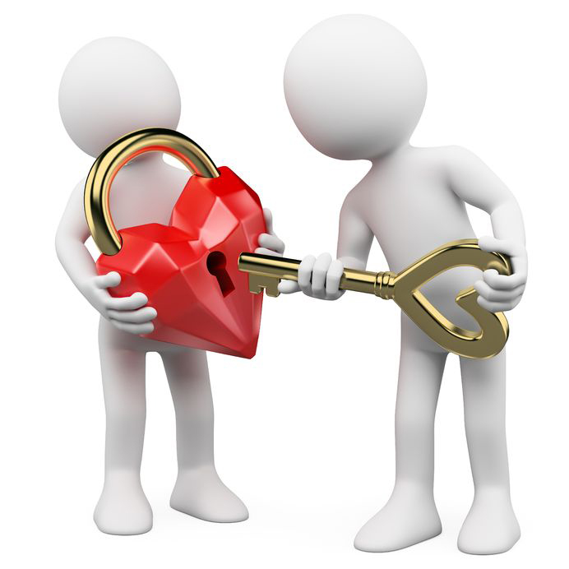
The steps to experiencing forgiveness:
Face your anger.
Ask God to give you the gift of forgiveness
Decide to forgive those who have hurt you.
Actively forgive.
Discover release
Notes:
Finally, the steps to experiencing forgiveness are straightforward.
First, face your anger. Recognize the feelings that are altering your attitude and behavior.
Second, ask God to give you the gift of forgiveness for the wrongs you have committed, and determine to make things right as far as possible.
Third, decide to forgive those who have hurt you. Ask God for the grace to leave others in His hands, and claim the promise that He will compensate you, or make up the difference, for any hurt done to you (Isaiah 61:7).
Fourth, actively forgive. Acknowledge your pain, but allow the experience to deepen your own wisdom, compassion, and empathy for others. Act on your new decision by the way you speak and behave.
Fifth, discover release from the emotional prison of unforgiveness. Realize that you are not alone, and that those who hurt are usually hurting people themselves. Use the experience of forgiveness to help others, and use the negative experience to grow in wisdom and develop a new purpose in your life.

Slide 19
CONCLUSION
This seminar has focused on two vital keys: connectedness with God and with one another. These two keys form the foundation for a lifestyle rooted in victory, growth, and security.
In Part 2, we will build on this foundation by exploring practical keys to creating a positive lifestyle and environment.
Notes:
This seminar has focused on two vital keys: connectedness with God and with one another. These two keys form the foundation for a lifestyle rooted in victory, growth, and security. In Part 2, we will build on this foundation by exploring practical keys to creating a positive lifestyle and environment.

Slide 20
Prayer
Prayer
Trust in the Lord with all your heart and lean not on your own understanding;
in all your ways submit to him, and he will make your paths straight.
Proverbs 3:5-6
Notes:
Prayer
Trust in the Lord with all your heart and lean not on your own understanding; in all your ways submit to him, and he will make your paths straight. Proverbs 3:5-6

